Slide 1



Slide 2

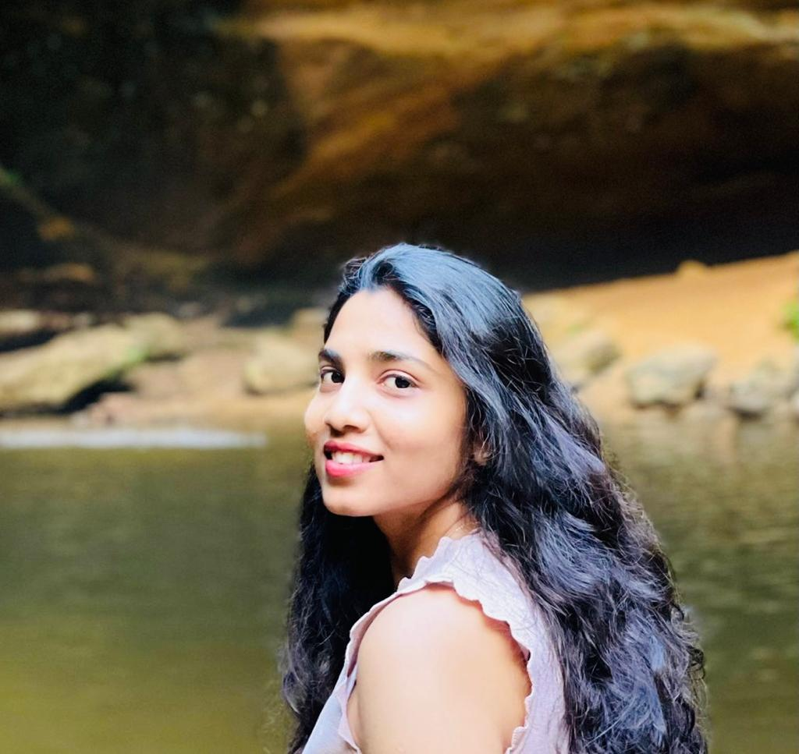
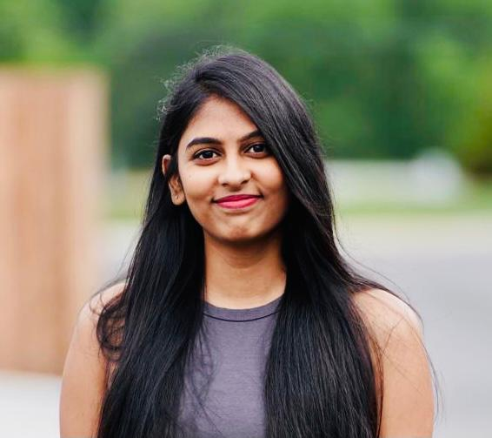
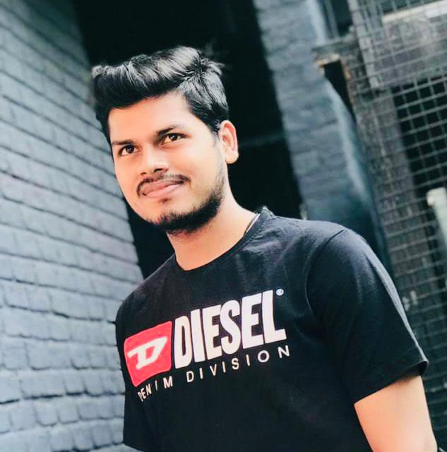
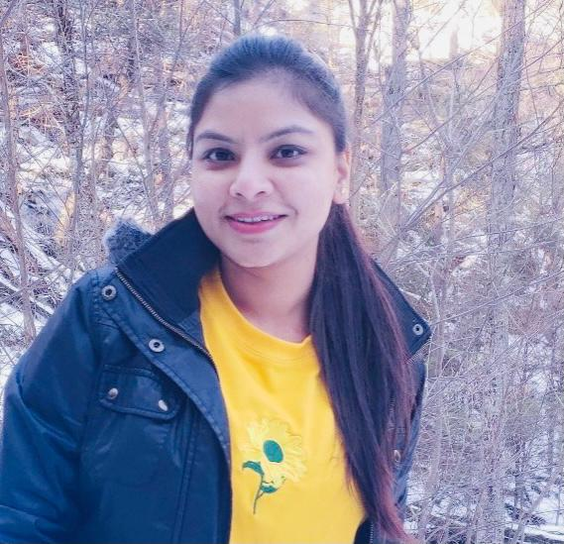
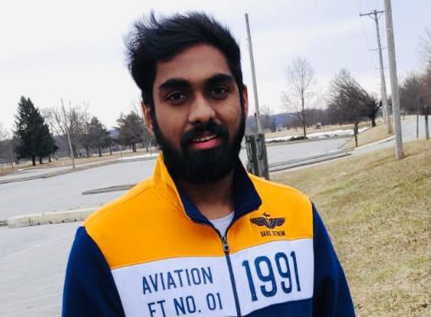
TARGET MARKET
Professionals
Students
Caretakers
Patients
Pavan Kumar
Jannaikode
Annapurna Marella
Lakshmi Haritha Aluri
VALUE PROPOSITIONS
Mental health parity
Free of cost
User support and satisfaction
Improved health outcomes.
Anju Madhukar
More
Srimithra
Kancharakuntla

Slide 3

KEY WINNING FACTORS
Community driven application with no cost.
We intend to provide community service with the help of psychology students and professionals.
It’s a win-win application for both students and patients.
We are planning to raise the funds and help users during the financial hardship.

Slide 4











CAPABILITIES
Immediate access for the users.
Activity board
Blog
Notifications
Chat box
Doctor appointments
Articles
YouTube videos
Questionnaire

Slide 5


JUSTIFICATION
Our maxim is to help the mental illness patients to over come the circumstance with a “community driven application” with the assistance of Psychology students
and doctors.

Slide 6




UI DESIGNS
USER LOGIN
STUDENT LOGIN
DOCTOR LOGIN
NAME
NUMBER
PASSWORD
GENDER
NAME
PASSWORD
UNIVERSITY
YEAR
GENDER
NAME
PASSWORD
CURRENT WORKING
EXPERIENCE
NUMBER
GENDER
HOME
ARTICLES BLOGS VIDEOS

Slide 7

August- September
Requirements gathering ,Market Research, Design Document
October
Implementing code using HTML,
CSS,JSP,JDBC,MY SQL.
November
Integrating all modules together and
testing application
December
Testing the Final project
and Deploying

Slide 8

CONCLUSION
We the BetterU team are planning to do a community driven application .
Our application is going to help everyone at the time of mental illness with no cost.
BetterU is going to work with psychology students to help users 24/7 with activities, articles and blogs.

